Slide 1
IIT – Introduction to Laser Safety

Slide 2

Introductory Laser Safety
This course is designed to provide an introduction to safe laser work. It does not cover any single specific laser system or experimental design at IIT. Speak with your PI to discuss the specific safety of your experimental system

Slide 3
Course outline
Fundamental Laser and Laser Safety Terminology
Laser Classifications
Laser effects on eye and skin
Non-beam hazards
Control measures

Slide 4
Fundamental Laser and Laser Safety Terminology

Slide 5
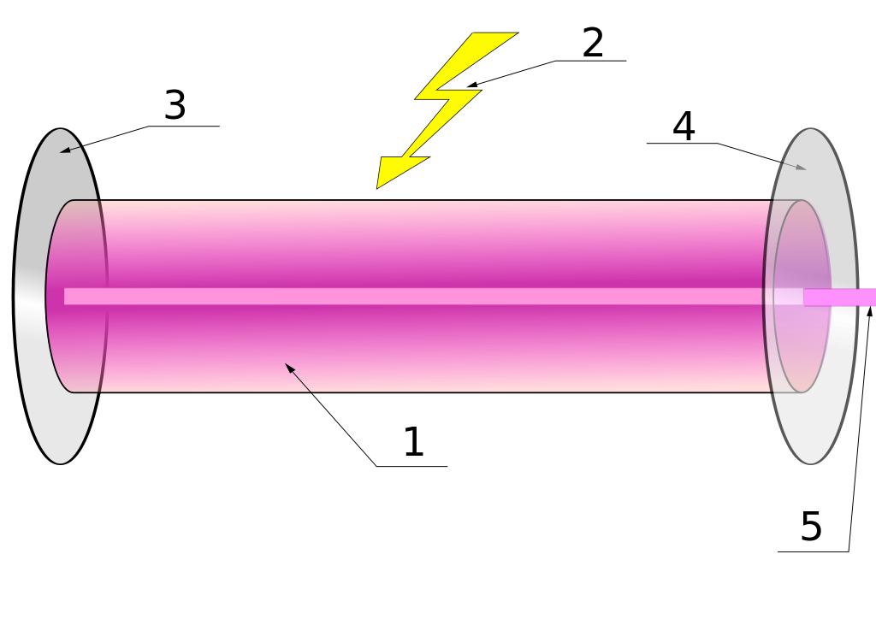
1: Gain Medium
2. Laser Pump energy
3. High reflectance coupler (“totally reflecting”)
4. Output coupler/partially reflecting mirror
5. Beam

Slide 6
Basic Laser Terminology
Radiant Energy, Q (unit: J)
Radiant Power, Φ (unit: W)
Radiant Exposure or Energy Density, H, (Pulsed laser, unit: J/cm²)
Irradiance or Power Density, E, (CW laser, unit: W/cm²)

Slide 7
Specular (mirror-like) reflections
Diffuse reflections
Size and orientations of surface irregularities determine the type of reflection
Specular: Irregularities < λ_{incident}
Diffuse: Irregularities > λ_{incident} , randomly oriented
Scattering

Slide 8
Absorption: transferring radiant energy to another form (heat)
Divergence: Angular spread of the beam over a distance (unit: milliradian)

Slide 9
Range | Wavelength | Range | Wavelength
UVC | 100-280 nm | IRA | 780-1400 nm
UVB | 280-315 nm | IRB | 1400-3000 nm
UVA | 315-400 nm | IRC | 3000nm – 1 mm
VISIBLE | 380-780 nm ANSI Defines as 400-700 nm

Slide 10
Typical research lasers
Excimer: UVA through UVC ranges
Carbon dioxide: 9600/10600 nm (IRC)
Nd:YAG: 1064 nm (typical, IRA)
Dye lasers: Variable and typically visible

Slide 11
Important laser safety terminology
Accessible Emission Limit (AEL)
The maximum power (W) accessible to eye/skin
Specific
Wavelength range
Exposure time
Aperture
Distance
For λ > 4µm it is power density (W/cm²)
Used for laser classifications

Slide 12
Aversion Response
Any physical movement (eyelid closure, eye movement, head turn, etc.) to avoid an exposure to a noxious or visible bright light stimulant. Assumed to be 0.25 sec.
Note that UV and IR sources will not have an aversion response!

Slide 13
Laser Controlled Area (LCA)
The laser use area where the occupancy and activity of those within is controlled and supervised.
Nominal Hazard Zone, NHZ
The space within which the level of direct, reflected, or scattered radiation may exceed the applicable Maximum Permissible Exposure (MPE).
Exposures outside the NHZ boundary are below the applicable MPE.

Slide 14
Maximum Permissible Exposure, MPE
The level of laser radiation to which an unprotected person may be exposed without adverse biological changes in the skin or eye.
Retinal hazard region
Defined as 400 nm – 1400 nm

Slide 15
Laser Classification

Slide 16
Laser Classifications
Lasers are broadly classified by hazard: the potential to inflict injury to workers
Particularly injury to eye and skin
Laser systems are classified – a Class 4 laser whose beam is completely enclosed while operating would be classified as a Class 1 system when operating.

Slide 17
Classifications give consideration to:
Wavelength
Pulse rate (for pulsed lasers)
Laser power (Peak power for pulsed lasers)
Generally speaking, end users will not classify lasers (except home-built ones)
The LSO and PIs may work together to classify a laser system though.

Slide 18
Class 1 Laser Systems
MPE cannot be exceeded at any time when viewing with the naked eye or with any typical magnifying optics
Fully enclosed beams are classified as Class 1 when operating
Usually considered “safe” under normal operation

Slide 19
Class 1M Laser Systems
Think “M” for “Magnification”
MPE may be exceeded if viewed through magnifying optics.
Usually considered “safe” unless viewed with magnifying optics

Slide 20
Class 2 Laser Systems
Only visible (400-700 nm) lasers
For CW lasers, power limited to 1mW
Aversion reflex provides protection (0.25 s)
Class 2M lasers - MPE may be exceeded if viewed through magnifying optics

Slide 21
Class 3 Laser Systems
Class 3R: Classification based on output
For λ < 400 nm or λ > 700 nm, accessible output between 1x-5x Class 1 AEL
For 400 nm < λ < 700 nm (i.e. visible), accessible output must be less than 5x Class 2 AEL (e.g. <5 mW).
This also defines the 3R AEL.

Slide 22
Class 3B:
Lasers operating < 400 nm or greater than 1400 nm and (1) can emit radiant power greater than 3R AEL but LESS THAN 0.5 W for T ≥ 0.25 sec or (2) cannot produce accessible radiant energy > 0.125 J with an exposure of T < 0.25 sec.
Lasers operating between 400-1400 nm, classification is dependent on radiant power (or energy for pulsed lasers) and exposure time.

Slide 23
Class 4 Laser Systems
All other lasers that exceed 3B AELs.

Slide 24
Laser Effects on Eye/Skin and
Non-beam hazards

Slide 25
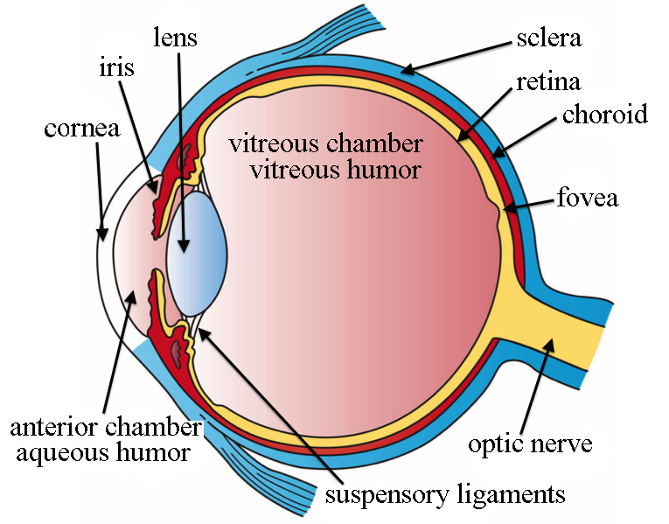

A little anatomy
By Artwork by Holly Fischer [CC BY 3.0 (http://creativecommons.org/licenses/by/3.0)], via Wikimedia Commons

Slide 26
Damage is wavelength dependent
UVA (315-400 nm)
Damage to lens
Delayed effect (sometimes years), cataracts
UVB/UVC (100-315 nm)
Damage to cornea
“Welder’s flash”

Slide 27
Visible and Near IR (400-1400 nm)
Light transmitted to retina with optical gain (~100,000)
Irradiance of 1mW/cm² → 100 W/cm²
“Flash blindness” and retinal burns/lesions
Far IR (1400 nm – 1mm)
Damage to cornea
Corneal burns

Slide 28
Pulsed lasers present other ocular issues – pressure transients in eye (pulses < 1ms)
Causes internal bleeding as well retinal damage

Slide 29
Skin damage – thermal burns in tissue
Skin layer penetration depends on wavelength and power
Photosensitive?
Some medications enhance photosensitivity

Slide 30
Non-beam hazards
Electrical
Homemade laser systems
Uncovered electrical connections
Improper grounding
Mechanically defeated interlocks for maintenance

Slide 31
Mechanical
Compressed gas cylinders
Noise issues with pulsed excimer lasers
Fire hazards from Class 4 lasers (irradiance > 10 W/cm² or power > 0.5 W)
Explosions from high pressure arc lamps, filament lamps and capacitors

Slide 32
Chemical
Some laser dyes are carcinogenic
Solvents are usually flammable
Laser generated air contaminants
Some can be carcinogenic (examples: polycyclic aromatic hydrocarbons, fused silica, benzene)
Toxicity

Slide 33
Other non-beam hazards
Some components may produce X-rays (ionizing radiation)
RF hazards may be present in plasma tubes or Q-switched lasers
Ergonomic considerations

Slide 34
Hazard Control

Slide 35
Controlling laser hazards
Layered control scheme
Engineered controls (“scientist-proof” controls)
Administrative controls (“rules”)
Personal protective equipment (PPE)

Slide 36
Engineered controls
Prevent unnecessary exposure to beam hazards
Key controls (and not leaving the keys in the laser!)
Housing interlocks
Door entry interlock
Emergency stops (power or shutter)
Curtains and warning signals/lights

Slide 37
Administrative Controls
If engineered controls are impractical or unavailable
Rules to limit access while laser is in use
Examples:
Curtain use to confine laser to NHZ
Work rules around lasers (i.e. energized equipment rules, chemical work rules, etc.)
Reducing laser power for aiming
Chemical handling rules

Slide 38
PPE
PPE includes
Minimizing exposed skin area (long sleeves)
Eye protection
Goggles must match wavelength and power to provide protection
Protection to less than MPE

Slide 39
Goggle selection
To get required Optical Density, need to know:
Wavelength
Power
Exposure time

Slide 40
Responsibilities
End users are responsible for:
Complete required training (including specific training for their own laser systems)
Wearing appropriate PPE
Following SOPs
Conducting operations in a safe manner

Slide 41
Principal Investigators are responsible for:
Supervising the safe use of lasers and ancillary equipment
Registration of all Class 3 and 4 Lasers
Notification to EHS of the intent to acquire or build an Class 3 or Class 4 laser

Slide 42
Creating and implementing SOPs
Ensuring their lab staff (including support staff) are trained
Meeting requirements on posting, access control, PPE and medical surveillance
Reporting known or suspected laser injuries
Procurement/moving requirements

Slide 43
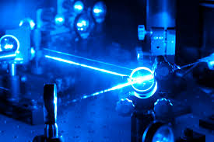
Conclusions
More information in the IIT Laser Safety Program

